Slide 1
Experimental Design
An Extension of the Scientific Method

Slide 2
Objectives
Distinguish between independent and dependent variables.
Formulate a tentative, testable hypothesis complete with independent and dependent variables.

Slide 3
The Scientific Method
Process used to study, investigate, and provide explanations for observed phenomenon in the natural world
It is empirical
Meaning that it’s based on experience and observations that are rational, testable, and repeatable

Slide 4
Steps of the Scientific Method
1. Make observations
2. Formulate a hypothesis
3. Devise a testable prediction
4. Conduct a critical experiment
5. Draw conclusions and make revisions

Slide 5
Research Question
What are your interests?
Choose a topic
Importance of preliminary research – research before you experiment
Measurements
Safety precautions
Clear and focused

Slide 6
Bad Research Question Example
What is the effect of global warming on animals?

Slide 7
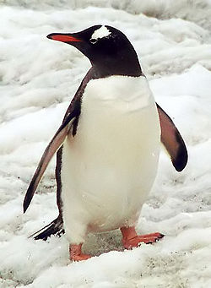
Good Research Question Example
How is glacier melting affecting penguins of Antarctica?
Clear
Specific
Focused

Slide 8
Hypothesis
A tentative (changeable) and testable proposed explanation for an observable phenomenon
Example: I think the termite will like the yellow highlighter.
With a good hypothesis, a prediction can be created in an “if-then” statement
Example: If the termite walks toward the yellow highlighter, then it must like it.

Slide 9
Purpose of the hypothesis
Tentative and testable
State the research question
Identify the variables

Slide 10
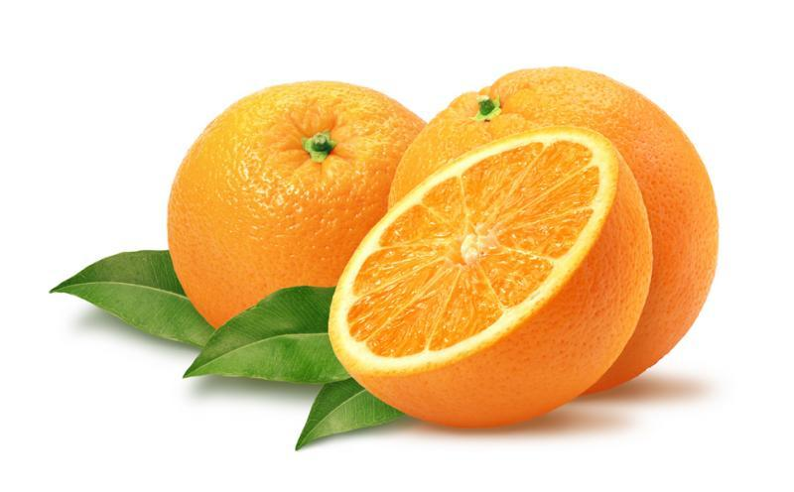
Do oranges sink or float?

Slide 11
Independent Variable
The manipulated variable
Quantity or quality is changed throughout the experiment

Slide 12
Dependent Variable
The responding variable
“depends on the independent variable”
Is measured (this is the data you record for your experiment)

Slide 13
Matching Activity
The increase in sunlight exposure of a tomato plant will increase the plant’s growth.
Increasing intake of sugary beverages, like soda and juice, will increase the amount of body fat in humans.
IV- sunlight exposure
DV- plant growth
IV- amount of sugary beverages ingested
DV- amount of body fat

Slide 14
Matching Activity
The increase in sunlight exposure of a tomato plant will increase the plant’s growth.
Increasing intake of sugary beverages, like soda and juice, will increase the amount of body fat in humans.
IV- sunlight exposure
DV- plant growth
IV- amount of sugary beverages ingested
DV- amount of body fat

Slide 15
Matching Activity
The increase in sunlight exposure of a tomato plant will increase the plant’s growth.
Increasing intake of sugary beverages, like soda and juice, will increase the amount of body fat in humans.
IV- sunlight exposure
DV- plant growth
IV- amount of sugary beverages ingested
DV- amount of body fat

Slide 16
More Matching
If a prisoner learns a work skill while in jail, then he is less likely to commit a crime when he is released.
If the ambient temperature increases, then an animal’s rate of metabolism will increase.
IV- learning of a work skill
DV- likelihood of committing a crime
IV- ambient temperature
DV- rate of metabolism

Slide 17
More Matching
If a prisoner learns a work skill while in jail, then he is less likely to commit a crime when he is released.
If the ambient temperature increases, then an animal’s rate of metabolism will increase.
IV- learning of a work skill
DV- likelihood of committing a crime
IV- ambient temperature
DV- rate of metabolism

Slide 18
More Matching
If a prisoner learns a work skill while in jail, then he is less likely to commit a crime when he is released.
If the ambient temperature increases, then an animal’s rate of metabolism will increase.
IV- learning of a work skill
DV- likelihood of committing a crime
IV- ambient temperature
DV- rate of metabolism

Slide 19
Example Hypotheses
If the amount of sediment in a river increases, then the water velocity will decrease.
If the amount of salt in the soil increases, then the plant rate of growth will decrease.
If fenders are placed on a bicycle, then the user will stay dry when going through puddles.

Slide 20
Let’s talk about the oranges…
Floating vs. sinking
With the peel vs. without the peel

Slide 21
Orange Hypothesis
What was your original hypothesis regarding the oranges?
Was your hypothesis supported or proved false?
Time for a group activity!

Slide 22
When choosing variables…
consider time, monetary, and safety constraints

Slide 23
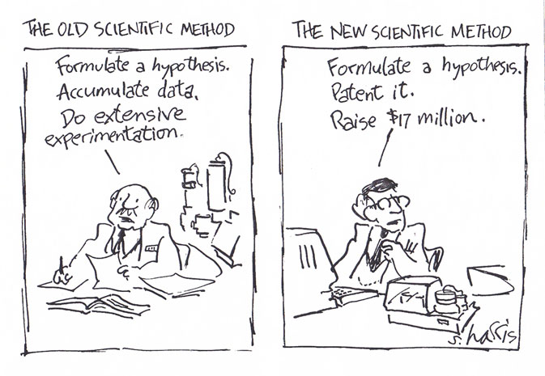
Hypothesis

Slide 24
Experimental Group
The groups or trials that receive all the same conditions except varying amounts or qualities of the independent variable (IV)
Example: presence of red pen
Trial- replication of the experimental and control group

Slide 25
Control Group
Group in the experiment that receives the exact same conditions as the experimental groups except that the independent variable is not changed
Used as a comparison group
Example: plain white paper

