Slide 1
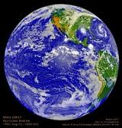
The Hydrosphere
On the BLUE Planet

Slide 2
Objectives
I can recognize the distribution of water on the Earth and the problems that this uneven distribution poses to humanity, biodiversity, and weather patterns.
I can analyze numerous articles to determine how infrastructure can negatively affect water quality in the example of the Glen Canyon Dam on the Colorado River.
I can perform water quality tests on a water sample.
I can analyze and interpret graphical representations regarding the water quality labs.

Slide 3
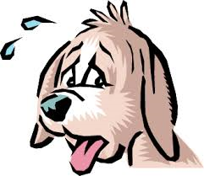
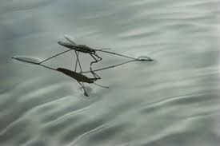
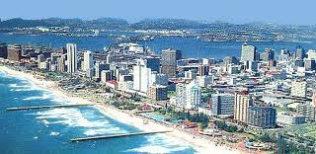
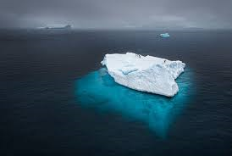
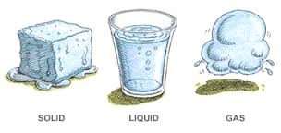
Water Qualities

Slide 4
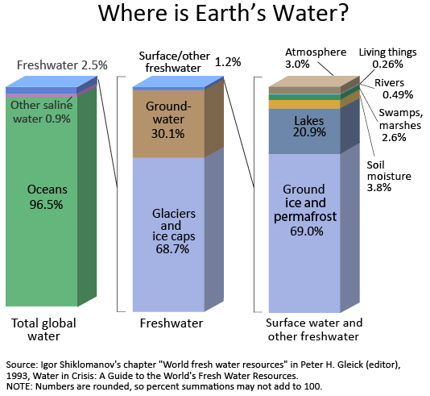
Water Distribution on Earth

Slide 5
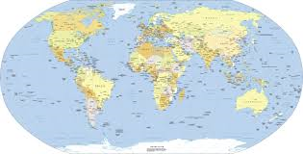
Water Availability per Capita
Water Rich Countries
Iceland, Surinam, Guyana, Papua New Guinea, Gabon, Solomon Islands, Canada, Norway, Panama, Brazil
Water Poor Countries
Kuwait, Egypt, United Arab Emirates, Malta, Jordan, Saudi Arabia, Singapore, Moldavia, Israel, Oman

Slide 6
Water Cycle
http://www.youtube.com/watch?v=9e1ccP2P0Fk

Slide 7
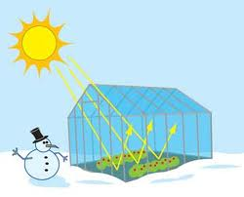
How is water present in the atmosphere?
Only 0.001% of total water supply
Most important mechanism for redistributing water throughout the world!
How does water vapor in the atmosphere affect global warming?
CO2 and H2O are Selective Absorbers
Greenhouse Effect

Slide 8
The Greenhouse Effect

Slide 9
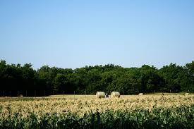
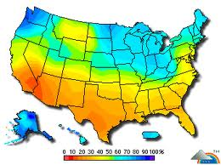
How does water vapor in the atmosphere affect climate?
What is the amount of water vapor in the air called?
Does this affect the temperature of the air?
How is this linked to the greenhouse effect?
Let’s Apply What We Know!

Slide 10
Does the ocean have a cycle?
Ocean circulation has 2 primary components:
Surface ocean currents
Deep ocean currents
What drives the surface ocean currents?
Only 10% of the ocean’s water
What circulates the other 90% of the ocean’s water?
http://www.youtube.com/watch?v=AFy9kGinZsk

Slide 11
Surface Currents

Slide 12
Deep water currents
Density – the mass per unit volume of a substance
Density current- the movement or flow of one mass of water over, under, or through another caused by density differences and gravity
Doesn’t easily mix with other currents but retains its own identity
Density differences are created by:
Salinity
Temperature

Slide 13
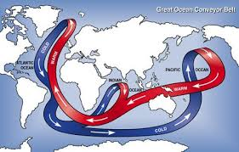
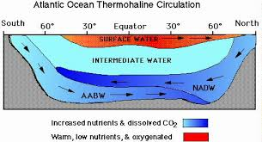
How thermohaline circulation works:
How are density and temperature related?

Slide 14
Connection: How can global warming affect the ocean currents?
Increase in cold water currents & disruption of warm water currents
Gulf Stream current has been reduced by up to 30% at times
Consequently can affect climate

Slide 15
Lakes have cycles, too!
Why is it important for a body of water to have a cycle?
How does the cycle of a freshwater lake work?
http://faculty.gvsu.edu/videticp/stratification.htm
How do fish breathe?

Slide 16
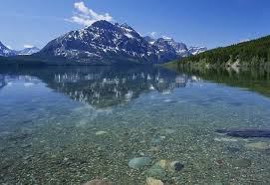
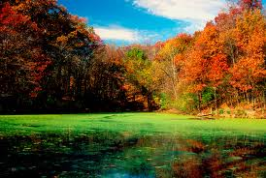
Types of Bodies of Freshwater
Oligotrophic
Eutrophic
“little nutrition”
Clear water and low biological productivity
“well-nourished”
Rich in organisms and organic material
High nutrient levels and biological productivity

Slide 17
Humans can cause eutrophication
How?
How can this affect the body of water?
Large increase in productivity at first in which fish and other organisms grow faster
Algal blooms can cause bacteria populations to explode
Bacteria depletes water of oxygen (hypoxia)
Dead zones

Slide 18
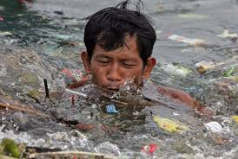
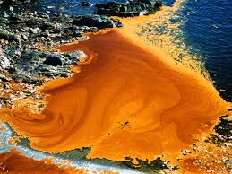
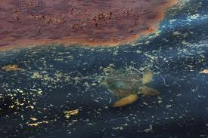
Pollution
pol·lute (verb)
contaminate (water, air, or a place) with harmful or poisonous substances.
Synonyms:
contaminate,
poison, taint,
foul, dirty,
adulterate

Slide 19
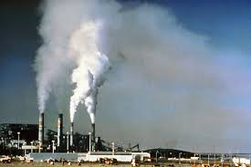
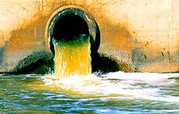
Pollution
Natural Causes
Anthropogenic Causes

Slide 20
Salt Pollution
Increase in salinity of water
How does this affect biodiversity?

Slide 21
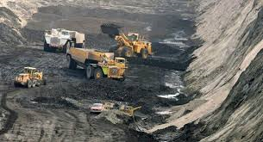
Acid Pollution
Acids are released as by-products of industrial processes
Coal mining is major source of acid pollution
How can this affect biosphere and the lithosphere?

Slide 22
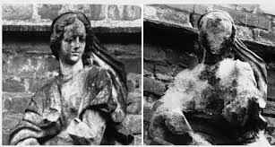
Acid Rain
Rain water has high nitric acid and/or sulfuric acid content
Often due to SO2 and NO2 emissions from the burning of fossil fuels

Slide 23
Thermal Pollution
Alters the water temperature
Major cause due to power plant cooling tubes
Causes can be altering vegetation, increasing sedimentation, reducing water flow, etc.
How does thermal pollution affect the environment?
What does heat do to chemical and metabolic reactions?

Slide 24
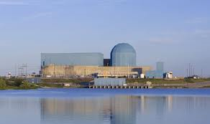
Thermal Pollution
Clinton Lake & Power Plant
Cycles lake water through tubes to cool the plant

Slide 25
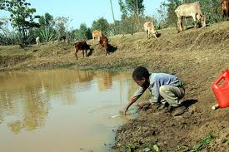
Pathogenic Pollution: Waterborne Diseases
Protozoan, Bacterial, Parasitic, & Viral
Mostly intestinal pathogens
Girardia, Tape worms, Shigella (dysentery), E. coli, Salmonella Typhi (typhoid Fever), Poliovirus
Cholera in the 17th century
Dispersed through public bath houses

Slide 26
Sedimentation
Can affect water quality, nutrient and oxygen availability, reduce sunlight, reduce vegetation, severely impair aquatic life
Makes water purification processes difficult

Slide 27
Red Tide
Naturally occurring dinoflagellate blooms
Unicellular protists
Can have bioluminescence
Some dinoflagellates produce neurotoxins dangerous to animals and humans
Can cause respiratory irritation and failure

Slide 28
Can infrastructure be a source of pollution?
In groups of 2-3, discuss whether or not you think infrastructure of any size can act as a source of pollution in a body of water.
Support your claim with evidence by providing an example.

Slide 29
Glen Canyon Dam Assignment
Complete the REAP strategy with the 2 resources below regarding the Glen Canyon Dam on the Colorado River
http://www.earthmagazine.org/article/releasing-flood-controversy-colorado-river
http://video.nationalgeographic.com/video/glen-canyon
Answer the questions on the next slide.

Slide 30
Glen Canyon Dam Assignment
Answer in complete sentences!
What was the hydrosphere, lithosphere, and biosphere like both before and after the dam was built?
Specifically how are scientists trying to fix the problems caused by the dam?
Do the solutions work at restoring the natural pre-dam ecosystems? Explain why or why not.
Brainstorm any other solutions that may help reduce infrastructure pollution.

Slide 31
“Water Quality Testing” Lab
You will be doing a water quality testing lab in groups of two. Make sure to bring a water sample!
What different things can affect the quality of water? What will you be testing for during this lab?
How will you measure each of these variables?
Use these resources to help answer the questions above:
www.sustainabletable.org/267/water-quality
http://ga.water.usgs.gov/edu/characteristics.html#Hardness

Slide 32
“Water Quality Testing” Lab
Tasks
Safety
You must test the water quality of your sample by using only the materials at each station.
Record your data for each of the tests.
After you have finished testing, create a Google Doc with:
A brief description of where you got your water sample
A data table with your results
A conclusion describing your data and your analysis of the quality of the water as compared to the pure water control
Share your document with me!
Do not drink or taste your water sample.
Do not place the Vernier probes in any other solution except your water sample when testing and distilled water when not in use.
Do not touch the water sample when testing for specific conductivity in case of shock.
Do not spill water samples on computers!

